Slide 1
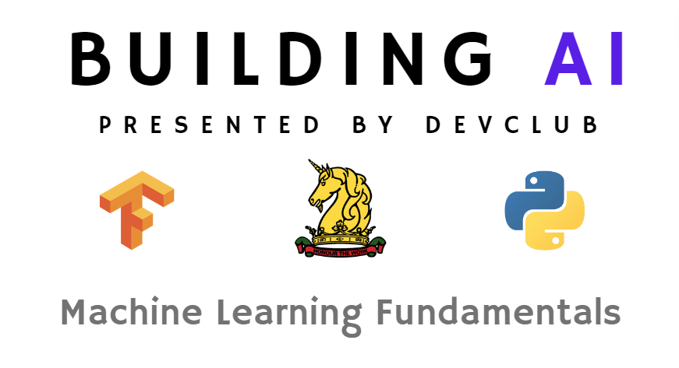

Slide 2
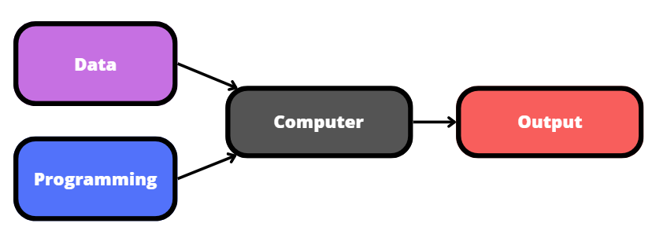
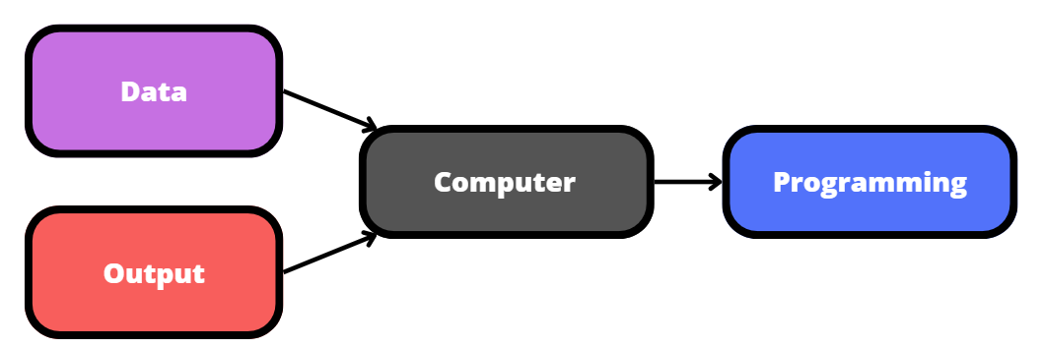
The Idea
Traditional Programming 😐
Machine Learning 🗣️🔥

Slide 3
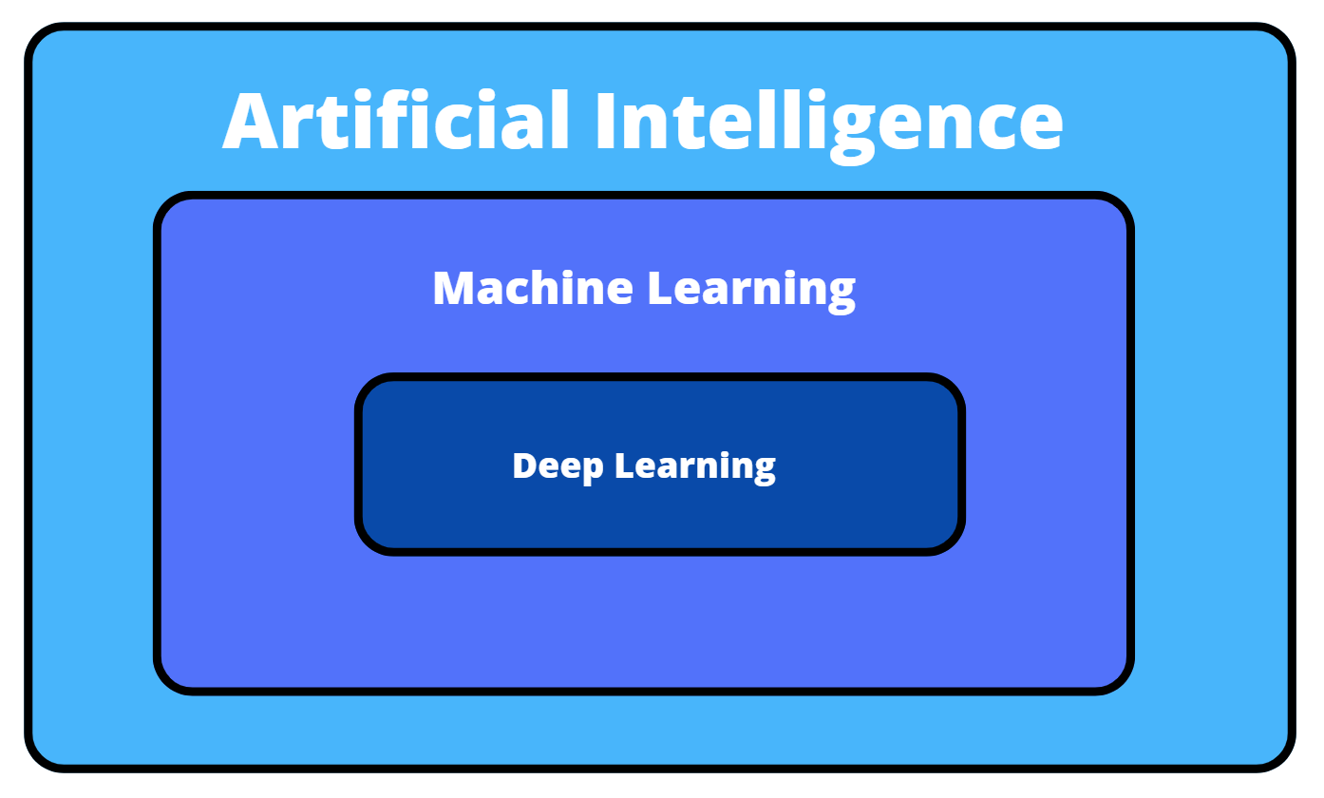
AI? ML? DL?

Slide 4
So How Does it Learn?
Supervised learning:
Data + output → Programming
Unsupervised learning:
Data → Programming
Reinforcement learning:
built diff

Slide 5

The Three Paradigms
Supervised learning:
Data + output → Programming
e.g classification, LLMs
Unsupervised learning:
Data → Programming
e.g clustering
Reinforcement learning:
built diff
e.g robotics, gameplay, LLMs*

Slide 6
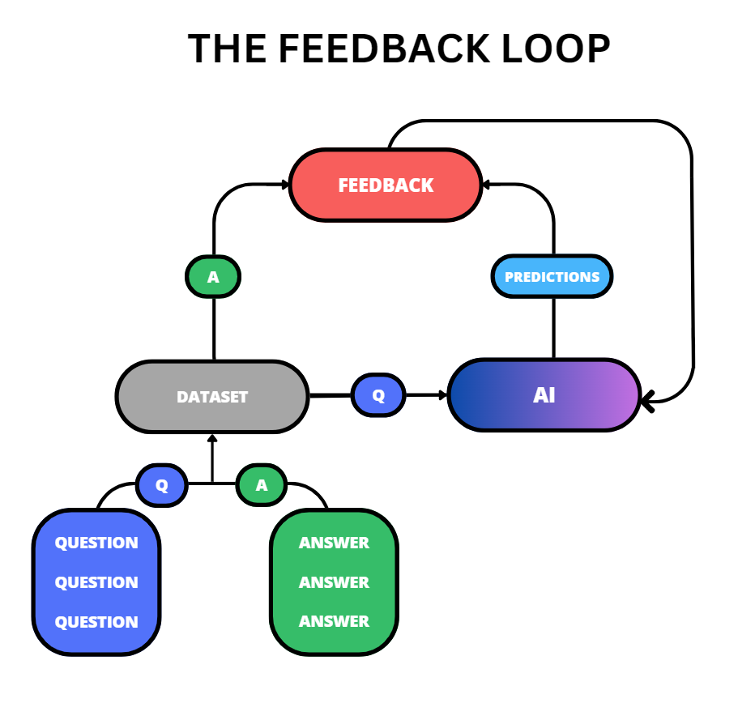
Supervised Learning?

Slide 7
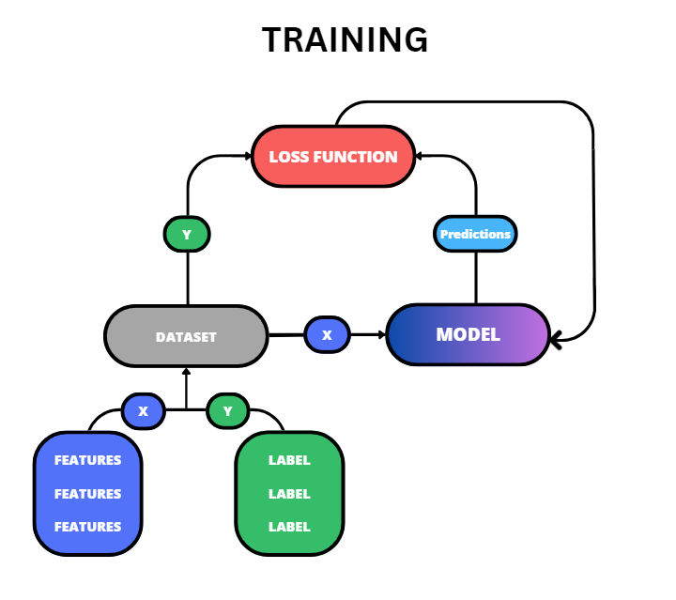
Supervised Learning

Slide 8

Supervised Learning

Slide 9
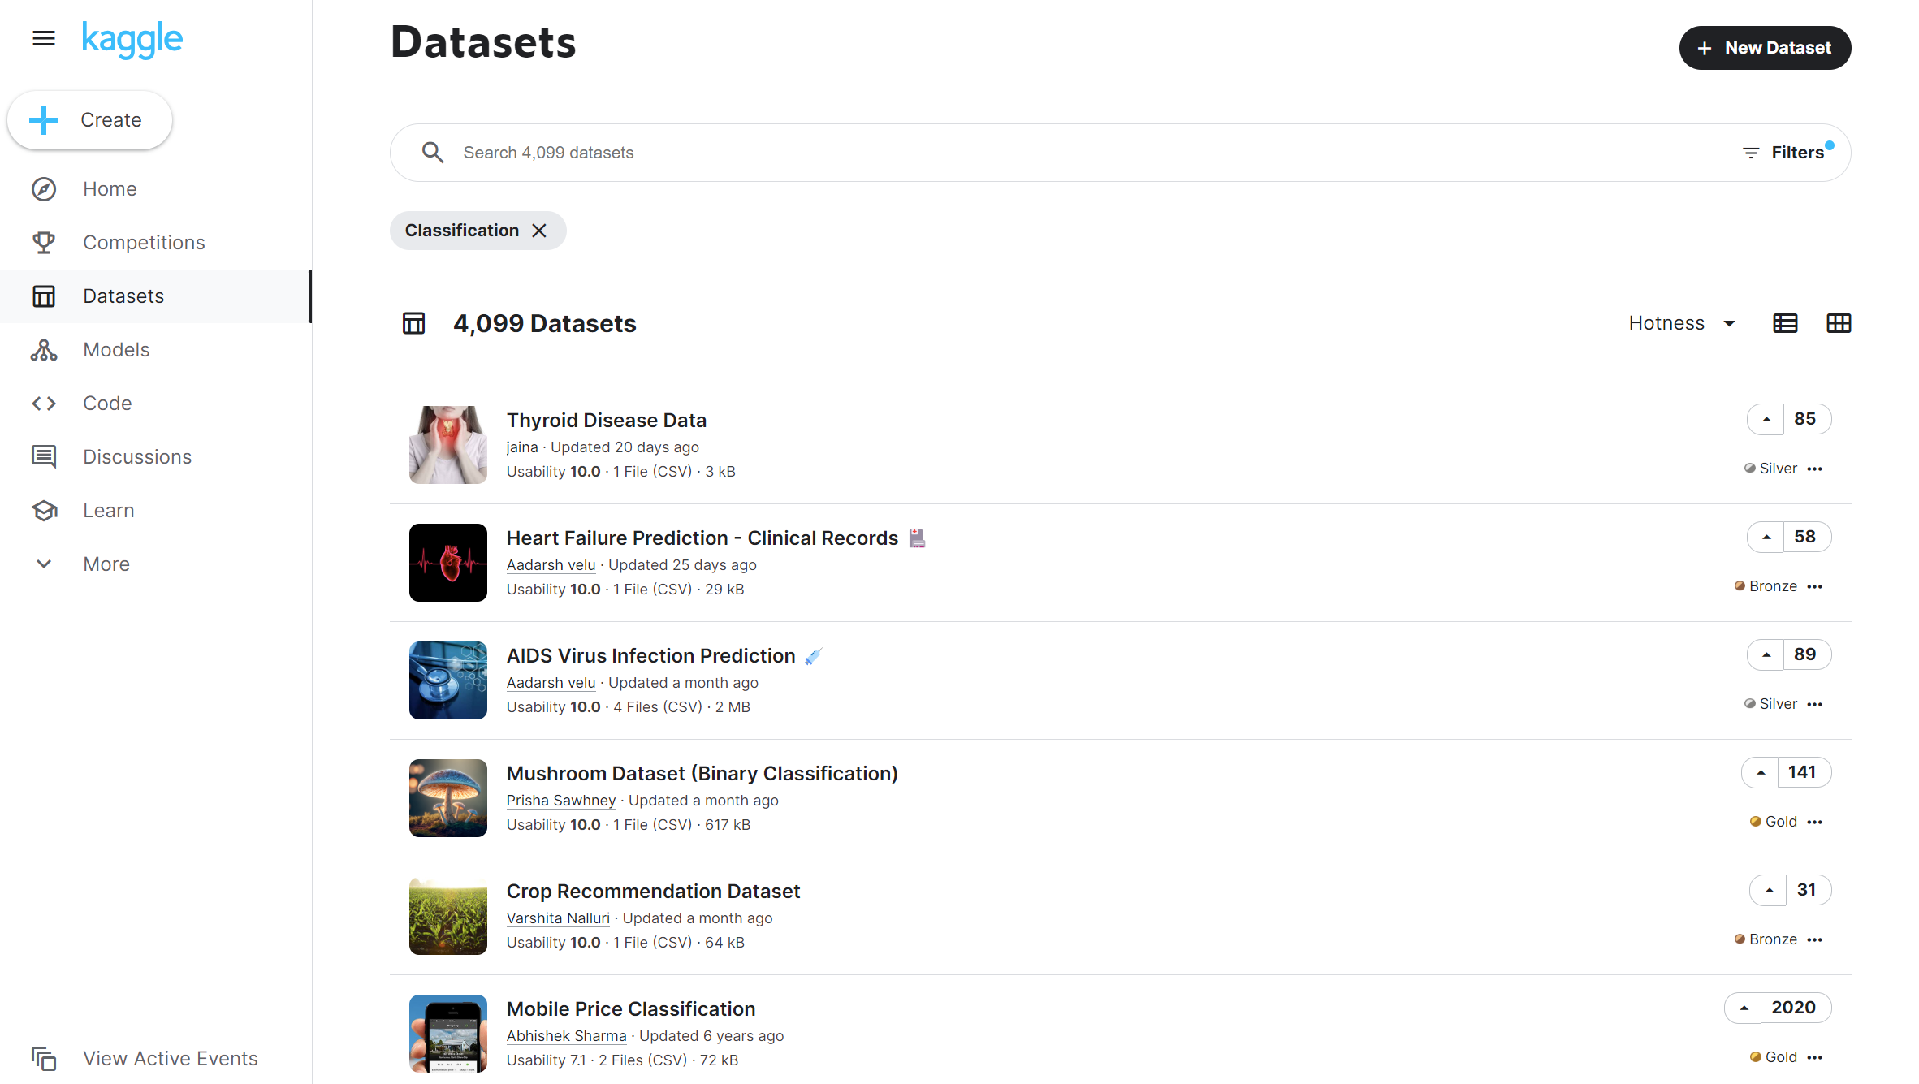
Kaggle: Datasets for ML

Slide 10
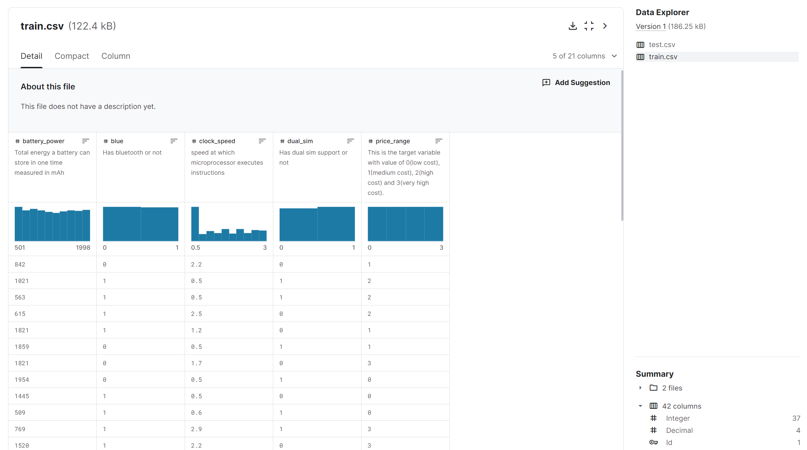
Dataset Format

Slide 11
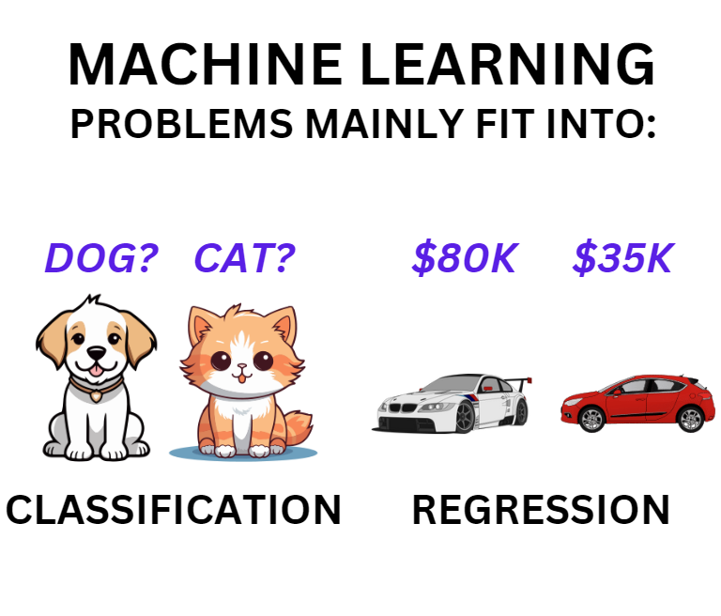

Slide 12
Visualisation and Models
Graphs are commonly used in ML to represent models
The x axis represents features and inputs
e.g battery life of a phone
The y axis represents labels and the expected output of a model
e.g price of the phone

Slide 13
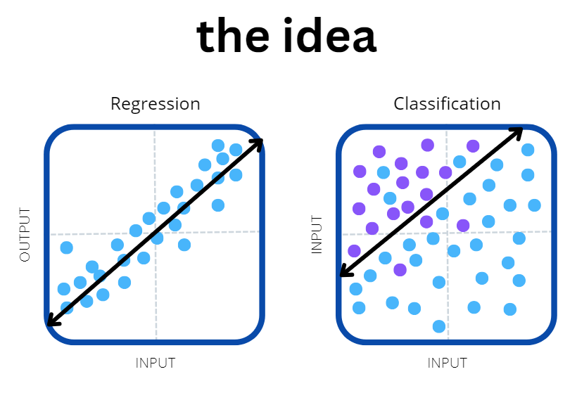

Slide 14


Slide 15
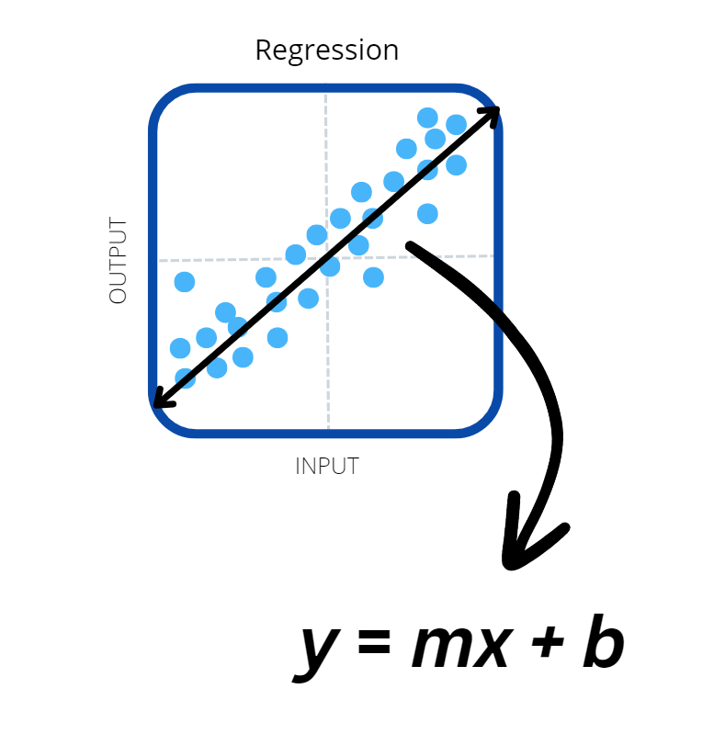
Linear Regression

Slide 16
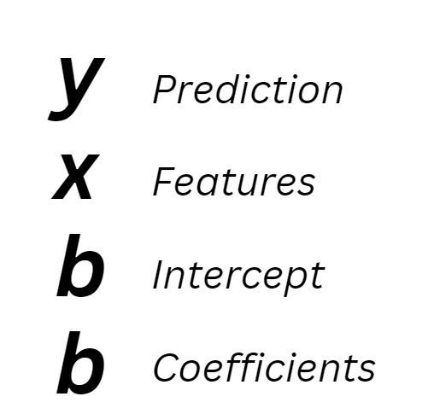
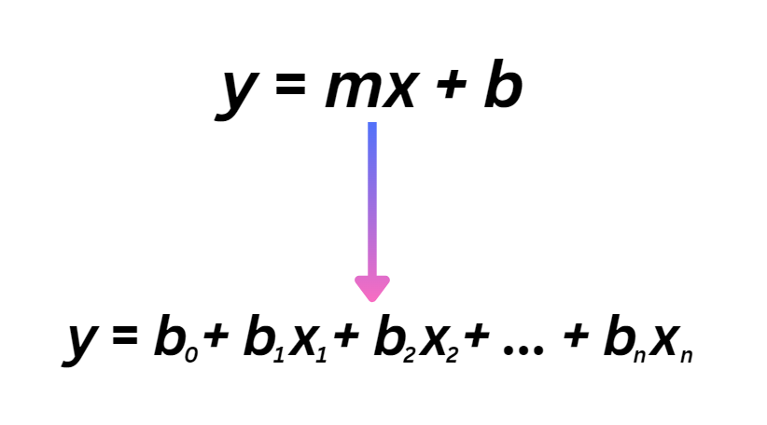
N-dimensional Linear Regression

Slide 17
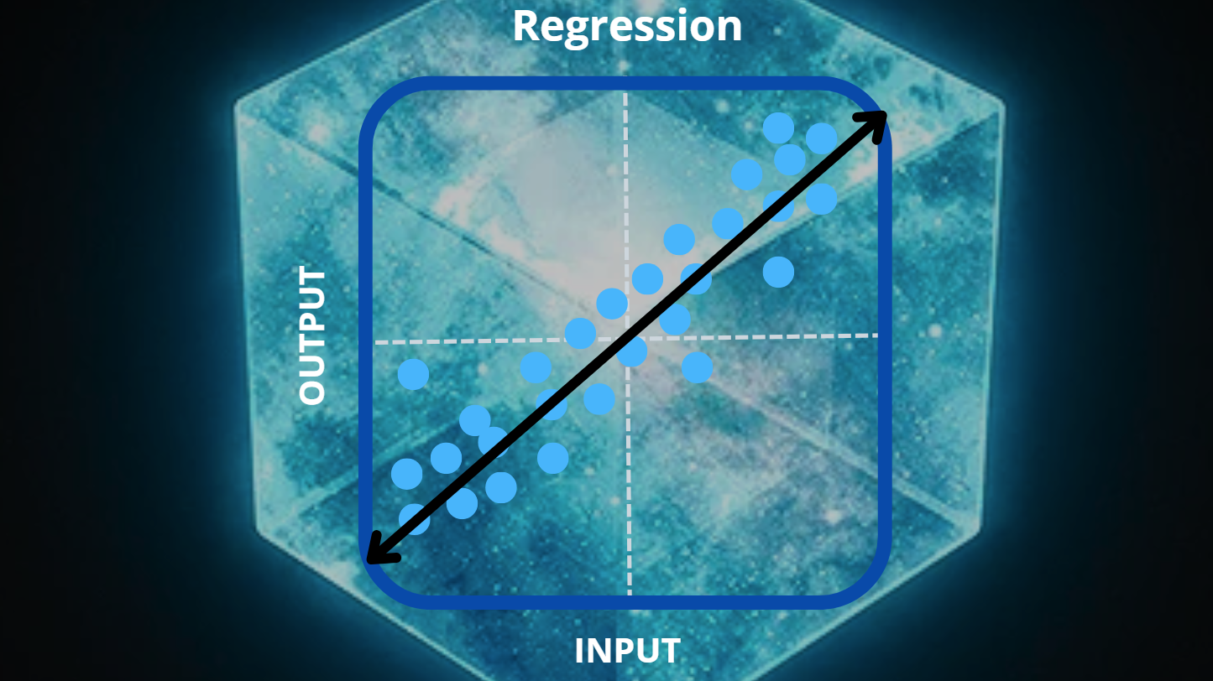

Slide 18
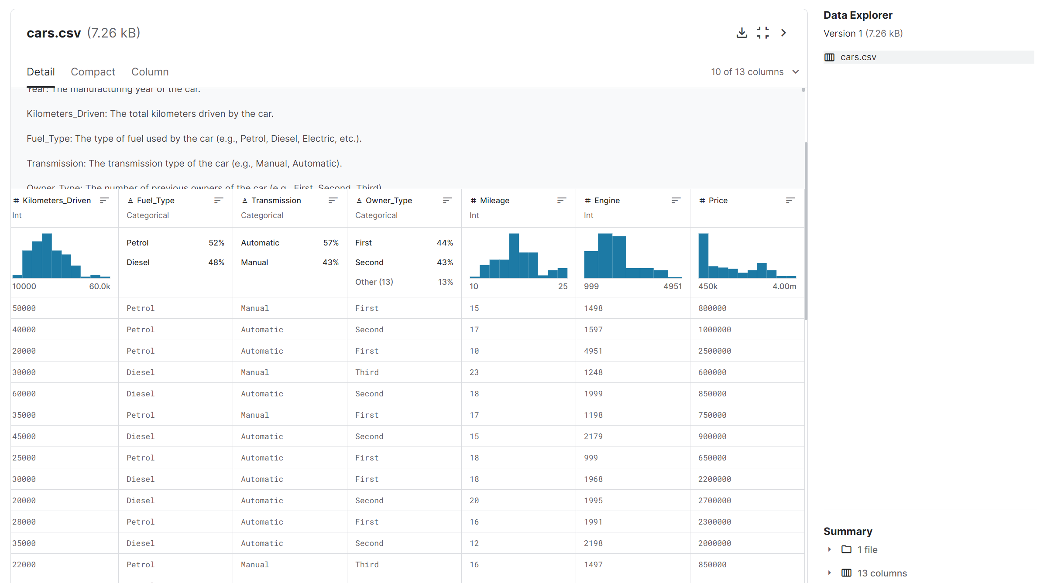
Let’s Run Through An Example

Slide 19
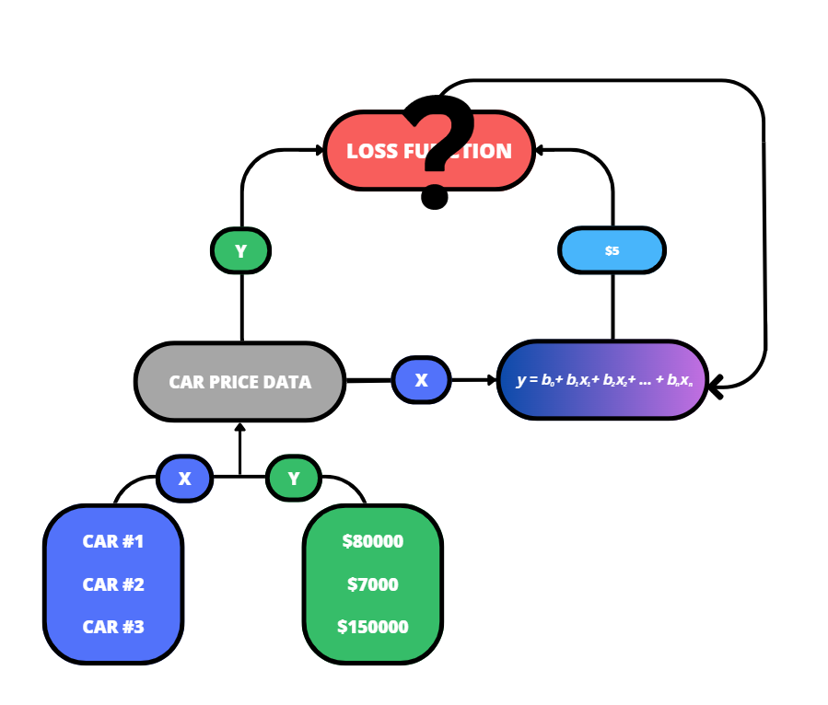

Slide 20
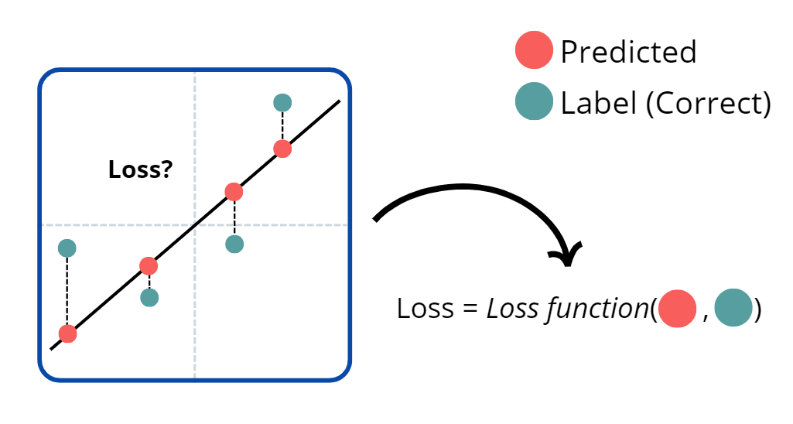
Loss Function

Slide 21
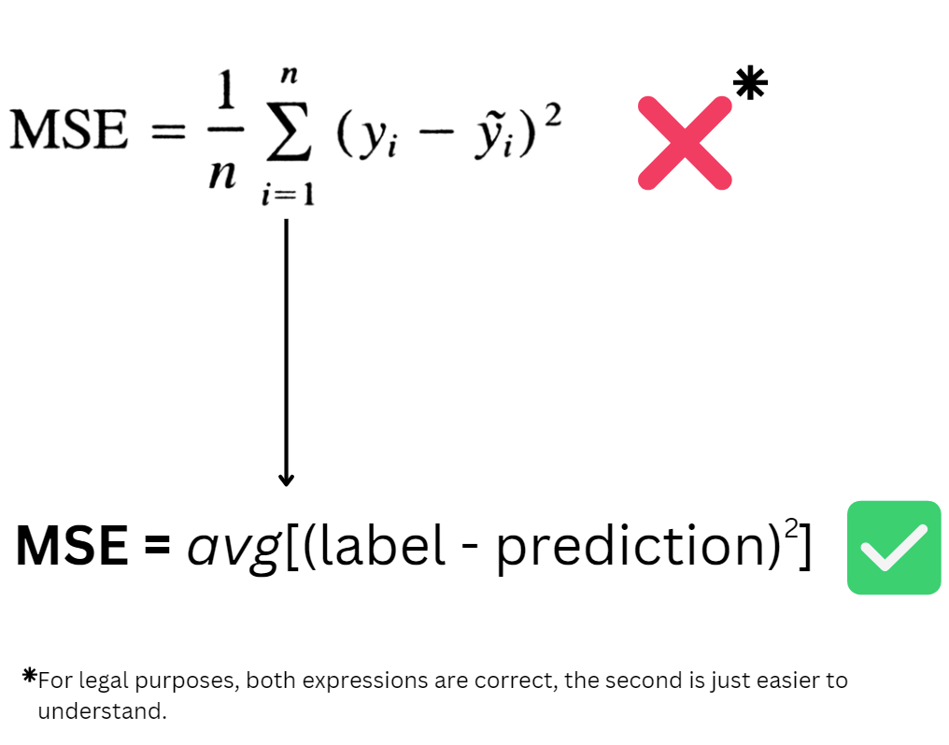

Slide 22
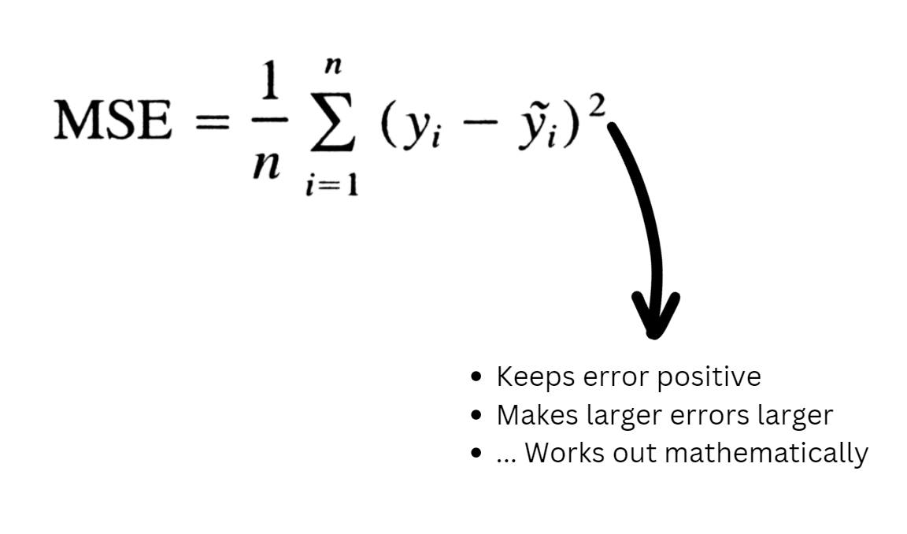

Slide 23
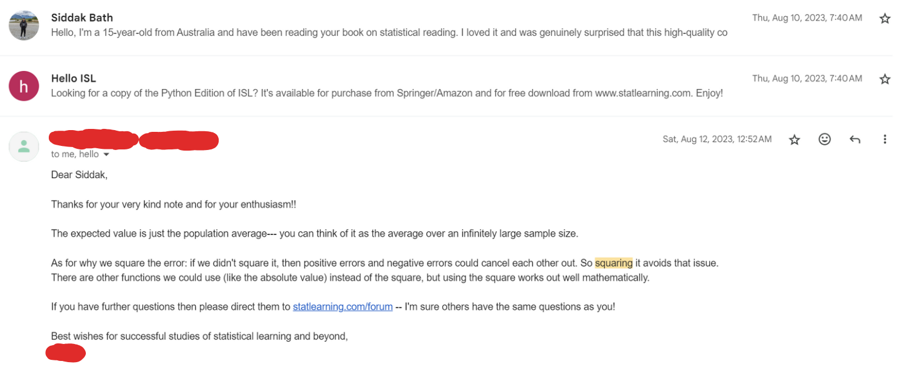
Don’t Believe Me?

Slide 24
Anyway
Let’s have a look at the bigger picture again

Slide 25
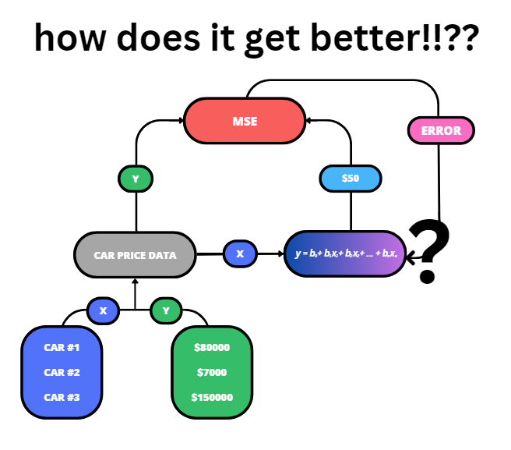

Slide 26
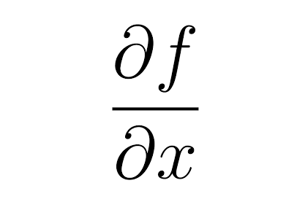
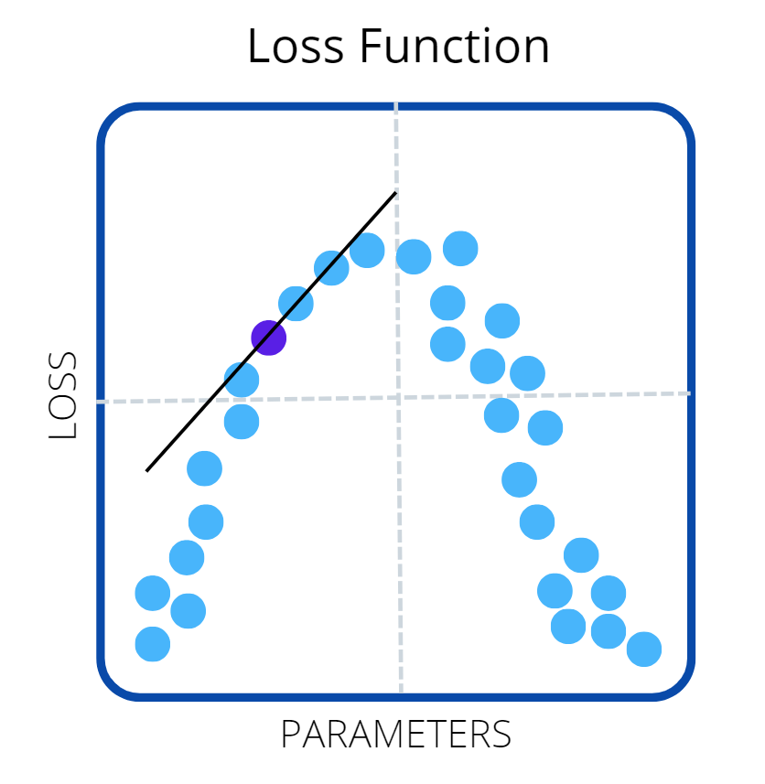
Partial Derivatives?
If you know what regular derivatives are,
a partial derivative of a function of several variables is its derivative with respect to one of those variables, with the others held constant (Wikipedia)
For the purposes of this,
partial derivatives represent the rate of change of the function with respect to a change in x

Slide 27
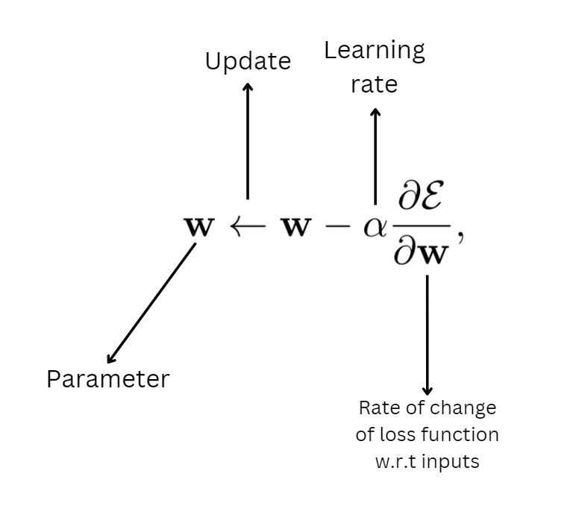

Slide 28
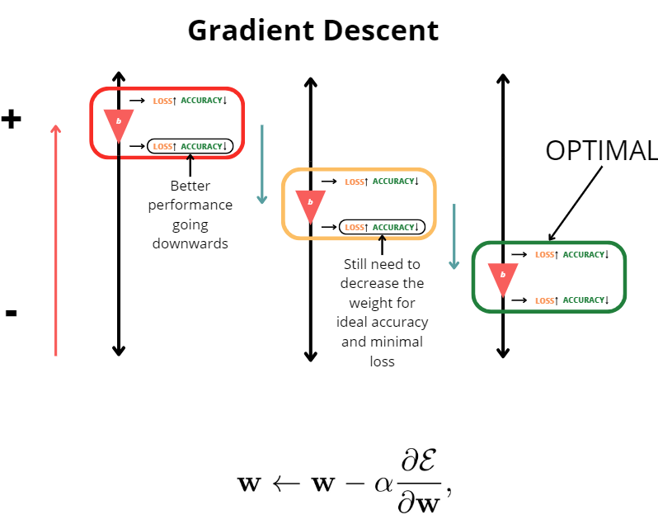

Slide 29
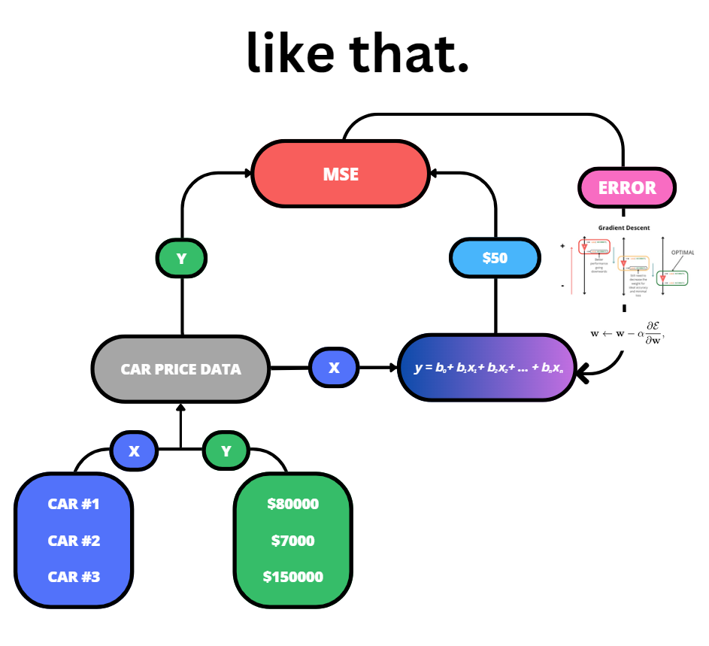

Slide 30
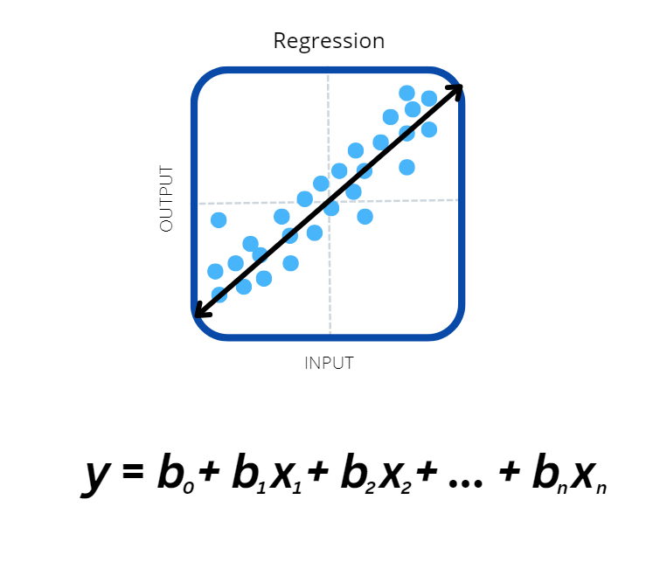
Advantages of Linear Regression
Simple to understand and implement
Computationally efficient
Interpretable model

Slide 31
Advantages of Linear Regression
Simple to understand and implement
Computationally efficient
Interpretable model
This applies to basically any basic ML algorithm

Slide 32
Disadvantages of Linear Regression
Assumes a linear relationship
Sensitive to outliers
This applies to basically any basic ML algorithm

Slide 33
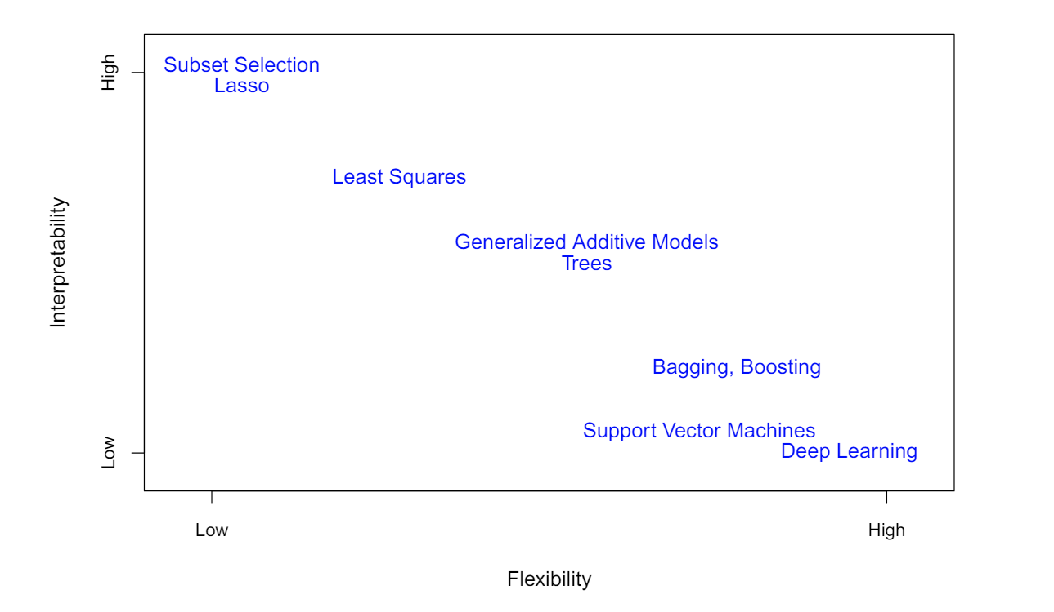
More Complex Models – The Trade Off
From “An Introduction to Statistical Learning”

Slide 34
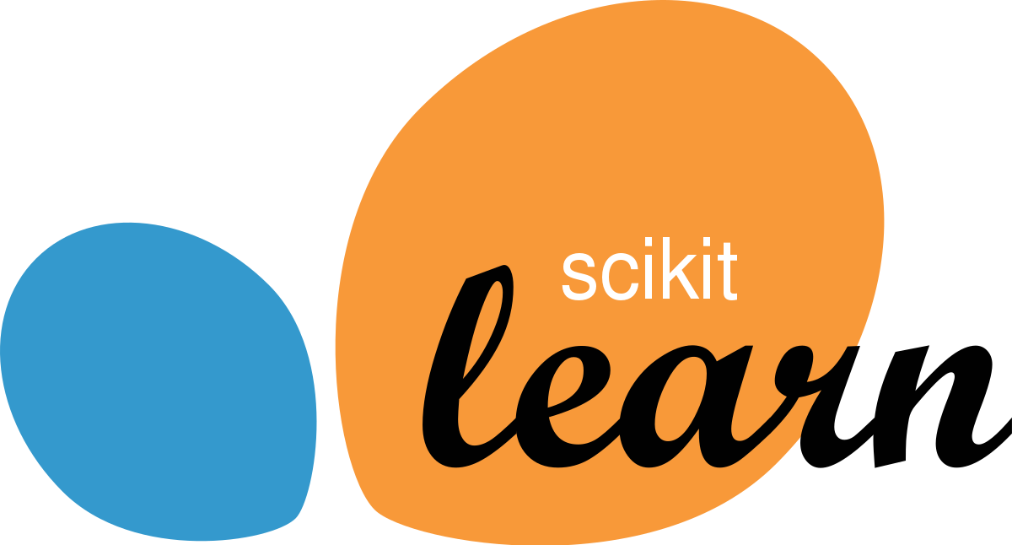

Next steps?
Build a simple ML model using sci-kit learn
Sci-kit learn is a popular framework used by data scientists
Through this, we’ll also unpack some of the important principles that go into building AI models
In the following workshops
Learn about neural networks
Build neural networks using TensorFlow
Python library for ML and AI by Google

Slide 35
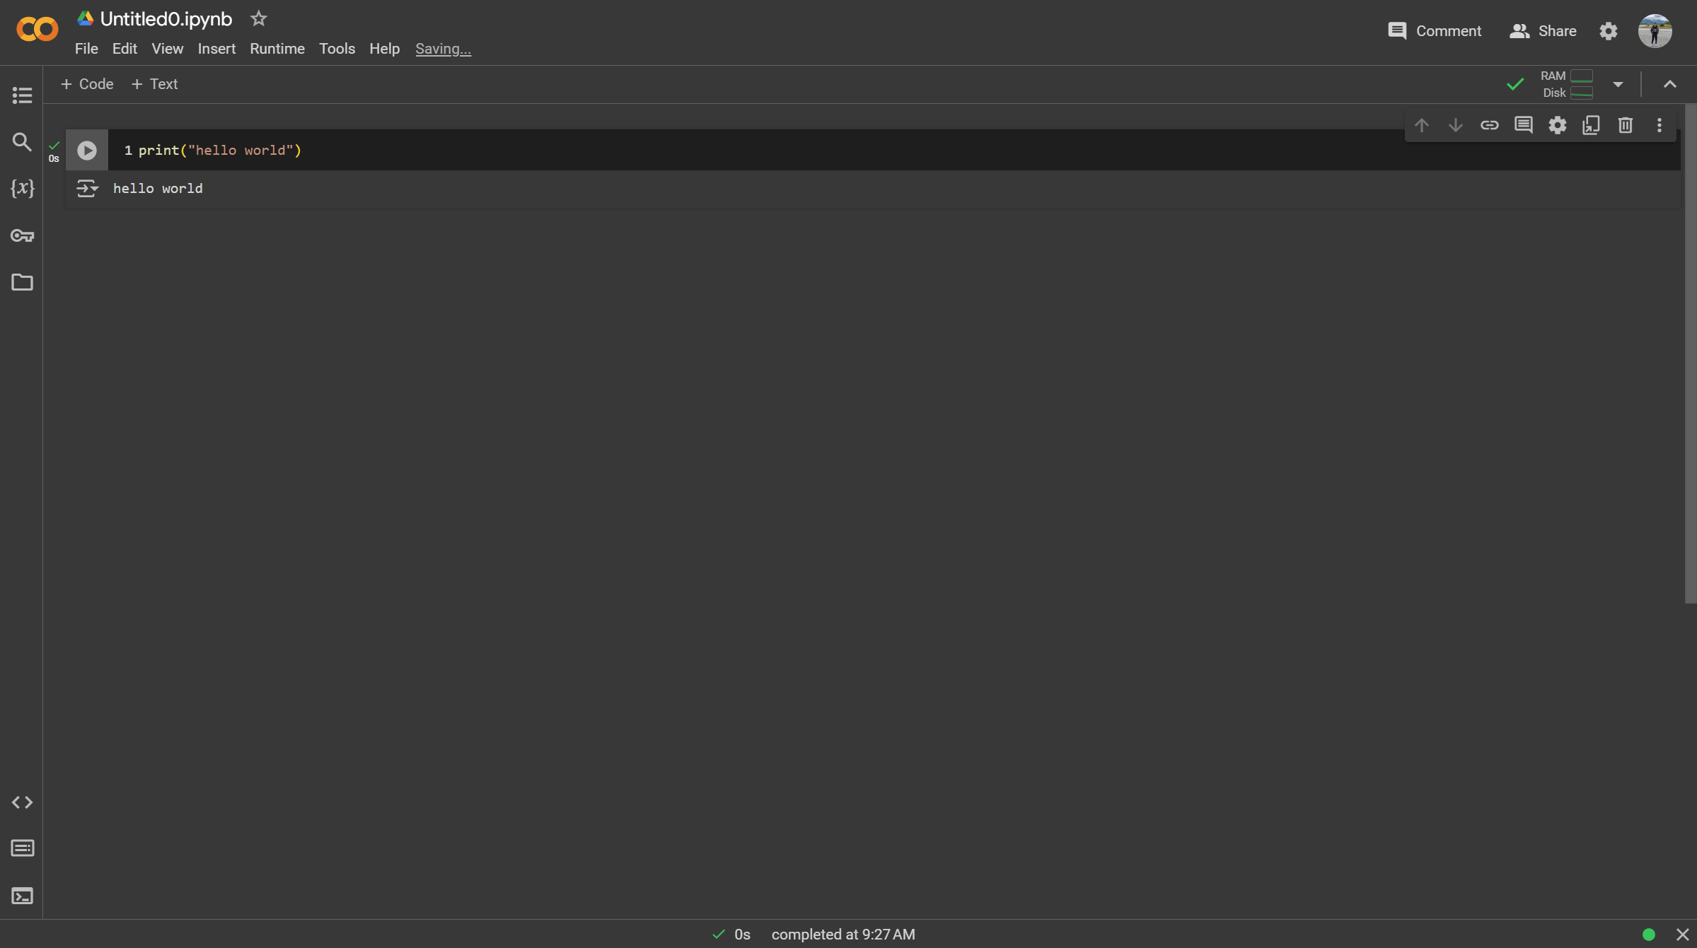
Just For Next Time
Make sure you have signed into Google Colaboratory (colab.research.google.com)
Create a new project
print("Hello, World!")

Slide 36
Thank you! Questions?
Presented on 31/05/24
(Diagrams/graphics originally produced using Canva)

